Slide 1
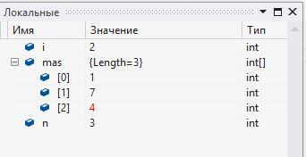
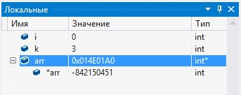
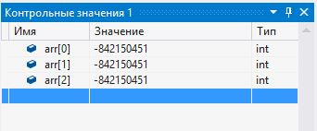
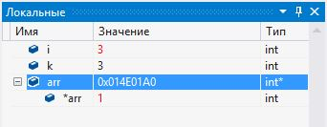
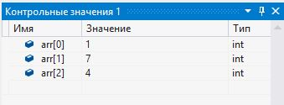
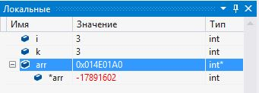
массивы
const int n=3;
int mas[n];
for(int i=0; i < n; i++)
mas[i]= rand()%10;
int k, *arr;
cin >> k;
arr= new int [k];
for(int i=0; i < n; i++)
arr[i]= rand()%10;
delete [] arr;

Slide 2
Массивы
int m[3][5];
j
0 | 1 | 2 | 3 | 4
0
1
2
$$m_{00}$$ | $$m_{01}$$ | $$m_{02}$$ | $$m_{03}$$ | $$m_{04}$$
$$m_{10}$$ | $$m_{11}$$ | $$m_{12}$$ | $$m_{13}$$ | $$m_{14}$$
$$m_{20}$$ | $$m_{21}$$ | $$m_{22}$$ | $$m_{23}$$ | $$m_{24}$$
i
m[i][j];

Slide 3
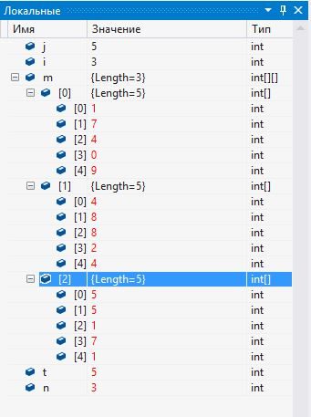
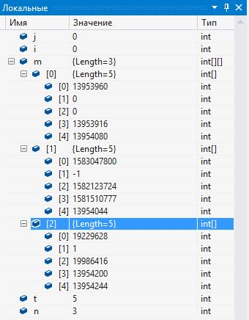
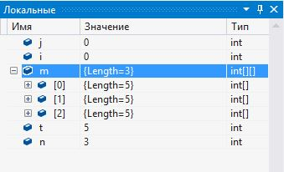
const int n=3;
const int t=5;
int m[n][t];
for(int i=0; i < n; i++)
for(int j=0; j < t; j++)
m[i][j]= rand()%10;

Slide 4
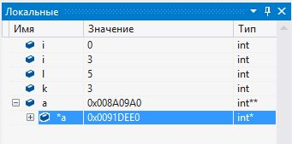
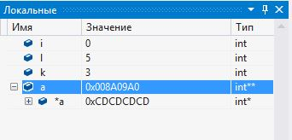
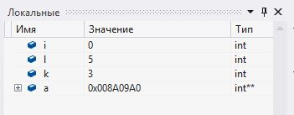
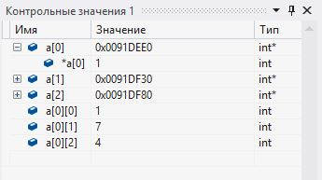
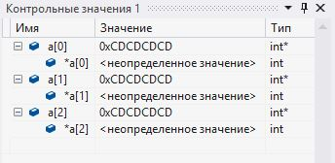
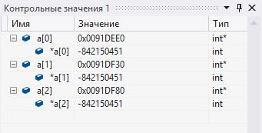
int k, l, **a;
cin >> k >> l;
a = new int* [k];
for(int i=0; i < k; i++)
a[i]= new int [l];
for(int i=0; i < k; i++)
for(int j=0; j < l; j++)
a[i][j]= rand()%10;
for(int i=0; i < k; i++)
delete [] a[i];
delete [] a;

Slide 5
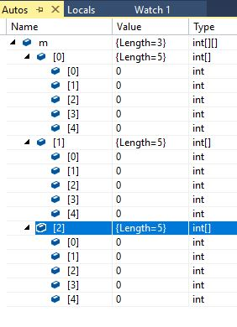
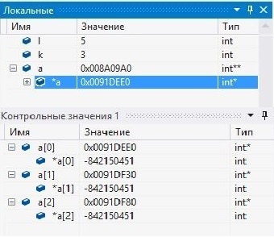
int m[3][5];
 |  | m[0] |  |  |  |  |  | m[1]
… | 0x0133f7b8 | … |  |  |  |  |  |  |  |  |  |  | …
 | int[][] |  | int | int | int | int | int | int | int | int | int | int | …
 | m | m[0][0] | m[0][1] | m[0][2] | m[0][3] | m[0][4] | m[0][5] | m[1][0] | m[1][1]
m[1][2]
int** a = new int* [k];
for(int i=0; i < k; i++)
a[i]= new int [l];
… | 0x008a09a0 | … | 0x0091dee0 | 0x0091df30 | 0x0091de80 | …
… |  |  |  |  |  | … | 1 | 7 | 4 | 8 | 5 | … | …
 | Int** a |  | Int* a[0] | Int* a[1] | Int* a[2]
 |  |  |  |  |  |  | int a[0][0] | Int a[0][1] | Int a[0][2] | Int a[0][3] | Int a[0][4]
 |  |  |  |  |  |  |  |  |  |  |  | … | …
int a[2][0] | Int a[2][1] | Int a[2][2] | Int a[2][3] | Int a[2][4] |  |  | int a[1][0] | Int a[1][1] | Int a[1][2] | Int a[1][3] | Int a[1][4]

