Slide 1
REST API

Slide 3
SOA — Service Oriented Architecture
Сервис:
Представляет собой функциональность с конкретным результатом
Является самодостаточным (self-contained)
Является черным ящиком для клиентов
Может состоять из других услуг

Slide 4
Service Description – информация о сервисе, необходимая для взаимодействия со службой
Service Provider – люди или организации, которые предоставляют сервисы.
Service Consumer – клиенты, потребители служб
Web Service — система, предназначенная для взаимодействия машин/программ по сети

Slide 5
XML-RPC — XML Remote Procedure Call
Запрос:
Host: service.com Content-Type: text/xml Content-length: 181 <?xml version="1.0"?> <methodCall> <methodName>examples.getRegionName</methodName> <params> <param> <value><i4>77</i4></value> </param> </params> </methodCall>
Ответ:
HTTP/1.1 200 OK Connection: close Content-Length: 158 Content-Type: text/xml Date: Tue, 21 Apr 2020 15:55:08 GMT Server: nginx/1.14.2 <?xml version="1.0"?> <methodResponse> <params> <param> <value><string>Moscow</string></value> </param> </params>
</methodResponse>

Slide 6
JSON-RPC — JSON Remote Procedure Call
способ кодирования данных
независимость от транспортного уровня
способность передачи извещений
возможность идентификации ответов при отправке нескольких запросов одновременно

Slide 7
SOAP — Simple Object Access Protocol
формат данных — XML
Все SOAP службы имеют описание на языке WSDL
транспорт: TCP, UDP, HTTP, SMTP, FTP и т.д.
поддержка GET и POST методов

Slide 8
REST — Representational State Transfer
REST — это не протокол. REST — это архитектура, набор правил
Client-Server
Stateless
Cache
Uniform Interface
Layered System
Code-On-Demand

Slide 9
Универсальный интерфейс
Identification of resources
Manipulation of resources through representations
Self-descriptive messages
HATEOAS

Slide 10
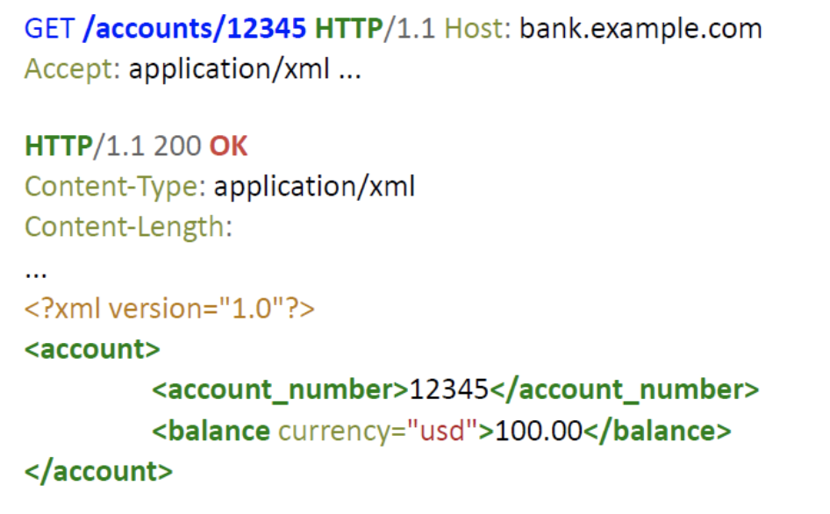

Slide 11
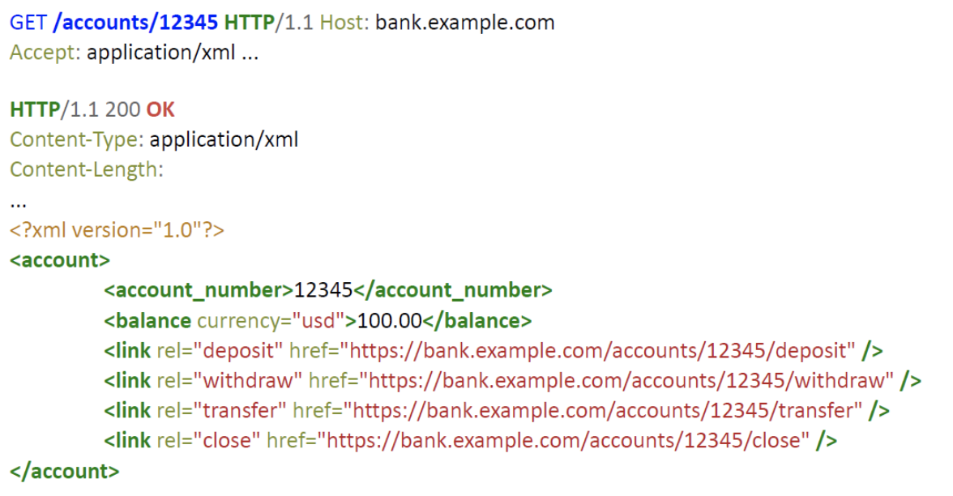

Slide 12
RMM
Richardson Maturity Model

Slide 13
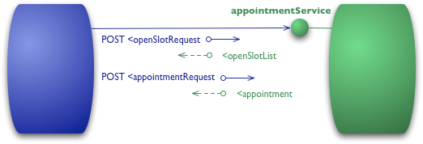
Уровень 0: Один URI, один HTTP метод

Slide 14
POST /appointmentService HTTP/1.1
[various other headers]
<openSlotRequest date = "2010-01-04" doctor = "mjones"/>
HTTP/1.1 200 OK
[various headers]
<openSlotList>
<slot start = "1400" end = "1450">
<doctor id = "mjones"/>
</slot>
<slot start = "1600" end = "1650">
<doctor id = "mjones"/>
</slot>
</openSlotList>

Slide 15
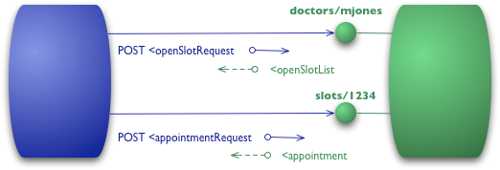
Уровень 1: Несколько URI, один HTTP метод

Slide 16
POST /doctors/mjones HTTP/1.1
[various other headers]
<openSlotRequest date = "2010-01-04"/>
HTTP/1.1 200 OK
[various headers]
<openSlotList>
<slot id = "1234" doctor = "mjones" start = "1400" end = "1450"/>
<slot id = "5678" doctor = "mjones" start = "1600" end = "1650"/> </openSlotList>
POST /slots/1234 HTTP/1.1
[various other headers]
<appointmentRequest>
<patient id = "jsmith"/>
</appointmentRequest>
HTTP/1.1 200 OK
[various headers]
<appointment>
<slot id = "1234" doctor = "mjones" start = "1400" end = "1450"/>
<patient id = "jsmith"/>
</appointment>

Slide 17
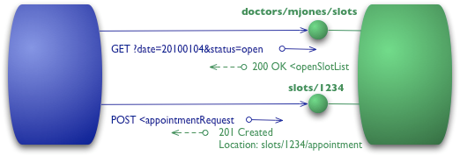
Уровень 2: Несколько URI, разные HTTP методы

Slide 18
GET /doctors/mjones/slots?date=20100104&status=open HTTP/1.1 Host: royalhope.nhs.uk
HTTP/1.1 200 OK
[various headers]
<openSlotList>
<slot id = "1234" doctor = "mjones" start = "1400" end = "1450"/>
<slot id = "5678" doctor = "mjones" start = "1600" end = "1650"/>
</openSlotList>
POST /slots/1234 HTTP/1.1
[various other headers]
<appointmentRequest>
<patient id = "jsmith"/>
</appointmentRequest>
HTTP/1.1 201
Created
Location: slots/1234/appointment
[various headers]
<appointment>
<slot id = "1234" doctor = "mjones" start = "1400" end = "1450"/>
<patient id = "jsmith"/>
</appointment>

Slide 19
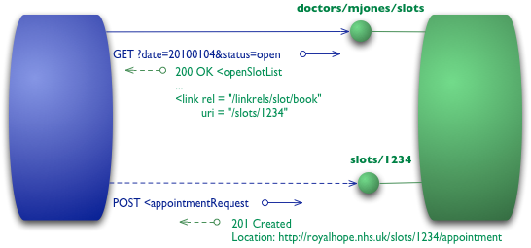
Уровень 3: HATEOAS
HATEOAS — Hypertext as the Engine of Application State

Slide 20
GET /doctors/mjones/slots?date=20100104&status=open HTTP/1.1
Host: royalhope.nhs.uk
HTTP/1.1 200 OK
[various headers]
<openSlotList>
<slot id = "1234" doctor = "mjones" start = "1400" end = "1450">
<link rel = "/linkrels/slot/book" uri = "/slots/1234"/>
</slot>
<slot id = "5678" doctor = "mjones" start = "1600" end = "1650">
<link rel = "/linkrels/slot/book" uri = "/slots/5678"/>
</slot>
</openSlotList>

Slide 21
POST /slots/1234 HTTP/1.1
[various other headers]
<appointmentRequest>
<patient id = "jsmith"/>
</appointmentRequest>
HTTP/1.1 201
Created Location: http://royalhope.nhs.uk/slots/1234/appointment
[various headers]
<appointment>
<slot id = "1234" doctor = "mjones" start = "1400" end = "1450"/>
<patient id = "jsmith"/>
<link rel = "/linkrels/appointment/cancel" uri = "/slots/1234/appointment"/>
<link rel = "/linkrels/appointment/addTest" uri = "/slots/1234/appointment/tests"/>
<link rel = "self" uri = "/slots/1234/appointment"/>
<link rel = "/linkrels/appointment/changeTime" uri = "/doctors/mjones/slots?date=20100104@status=open"/>
<link rel = "/linkrels/appointment/updateContactInfo" uri = "/patients/jsmith/contactInfo"/>
<link rel = "/linkrels/help" uri = "/help/appointment"/>
</appointment>

